Slide 1

WAY TO ENTERPRISE
AWS
VTI ACADEMY
Author: duy.nguyenngoc1@vti.com.vn

Slide 2
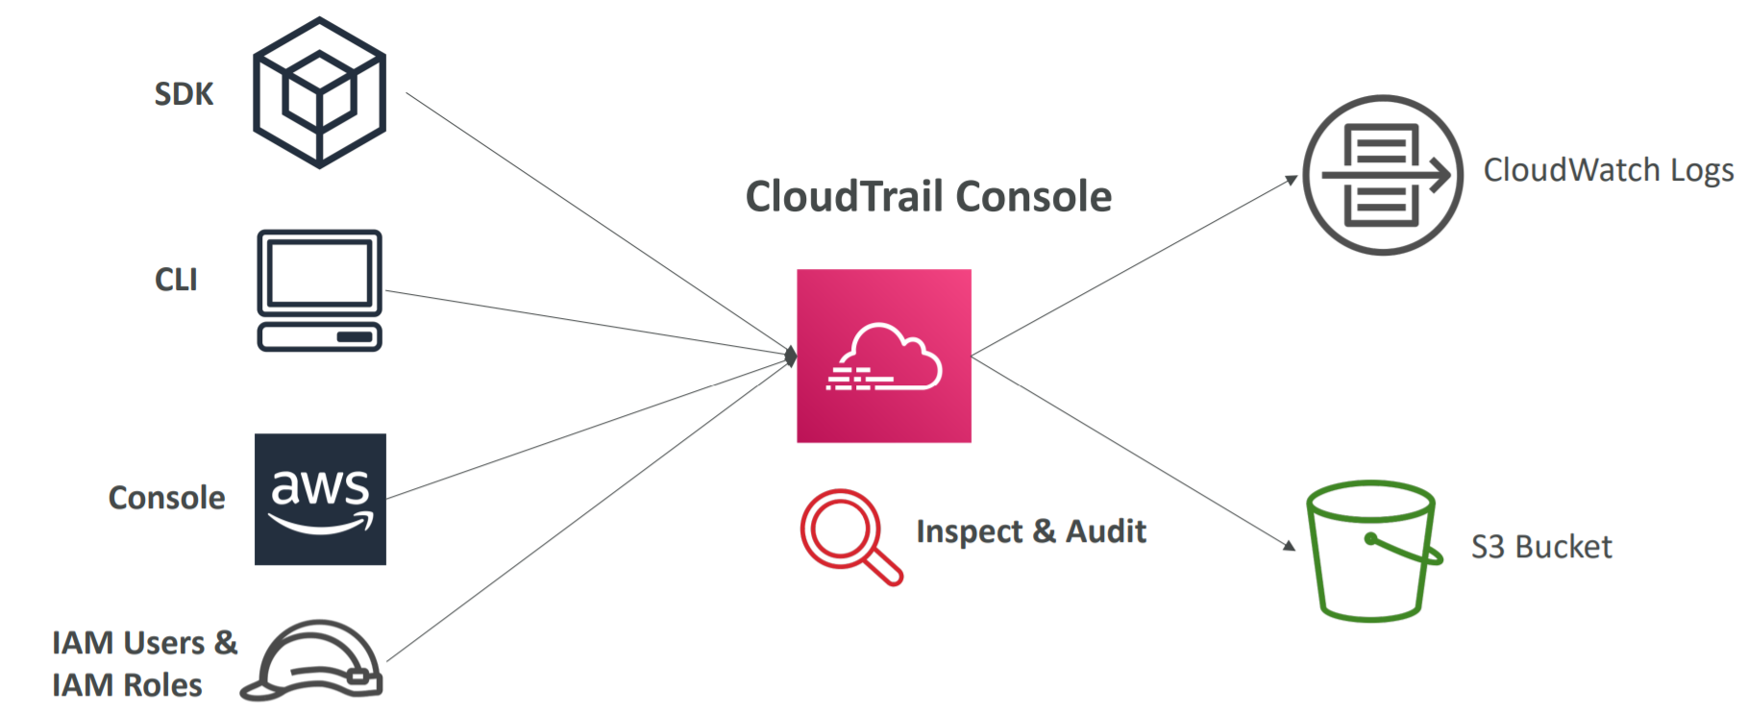
CloudTrail Service
Provides governance, compliance, audit for your AWS Account
Get an history of API calls made within your AWS Account by: Console, SDK, CLI, AWS Services
Put logs from CloudTrail into CloudWatch Logs or S3

Slide 3
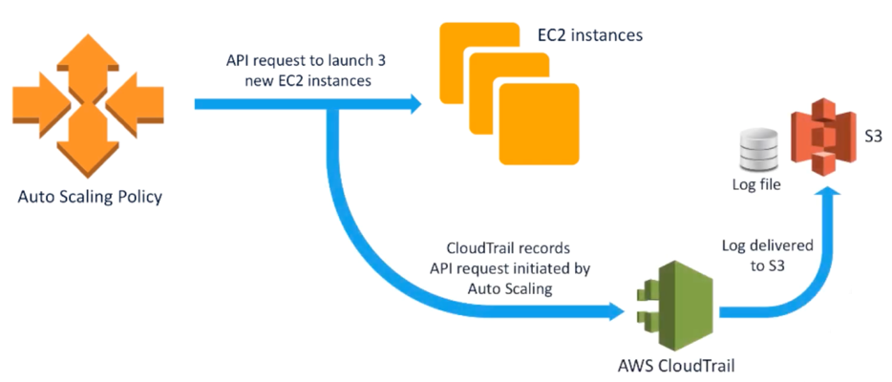
CloudTrail Service
Default: Enable for All Regions
Usecases
  Security analysis
  Operational issue troubleshooting
Price: https://aws.amazon.com/cloudtrail/pricing
https://docs.aws.amazon.com/awscloudtrail/latest/userguide/cloudtrail-user-guide.html

Slide 4
CloudTrail Service
Demo
  Event History
  Create Trail
  Test
  Dashboard

Slide 5
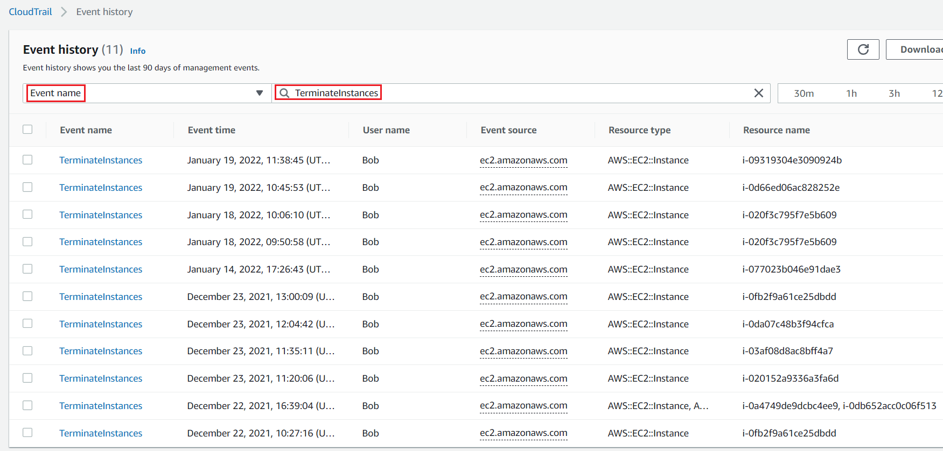
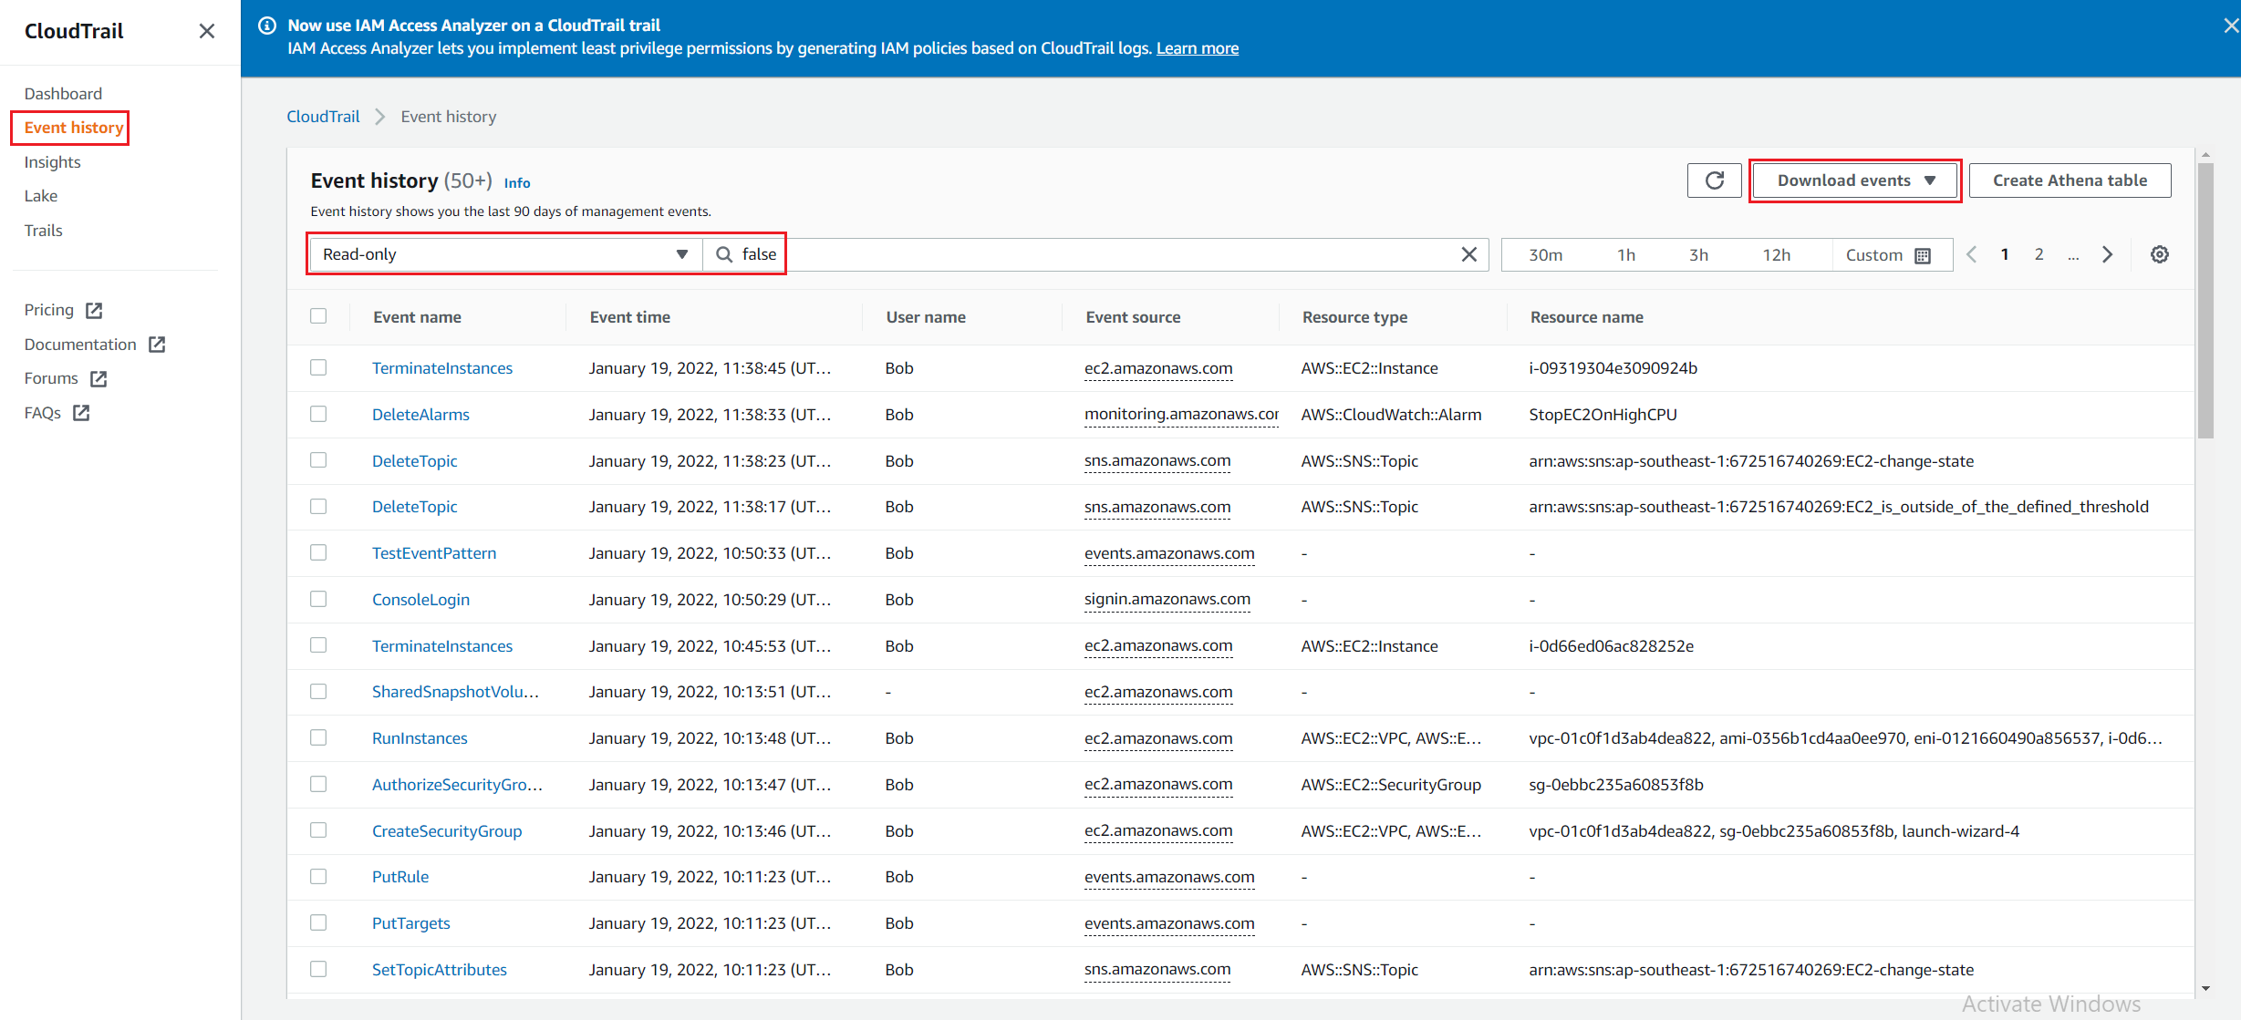
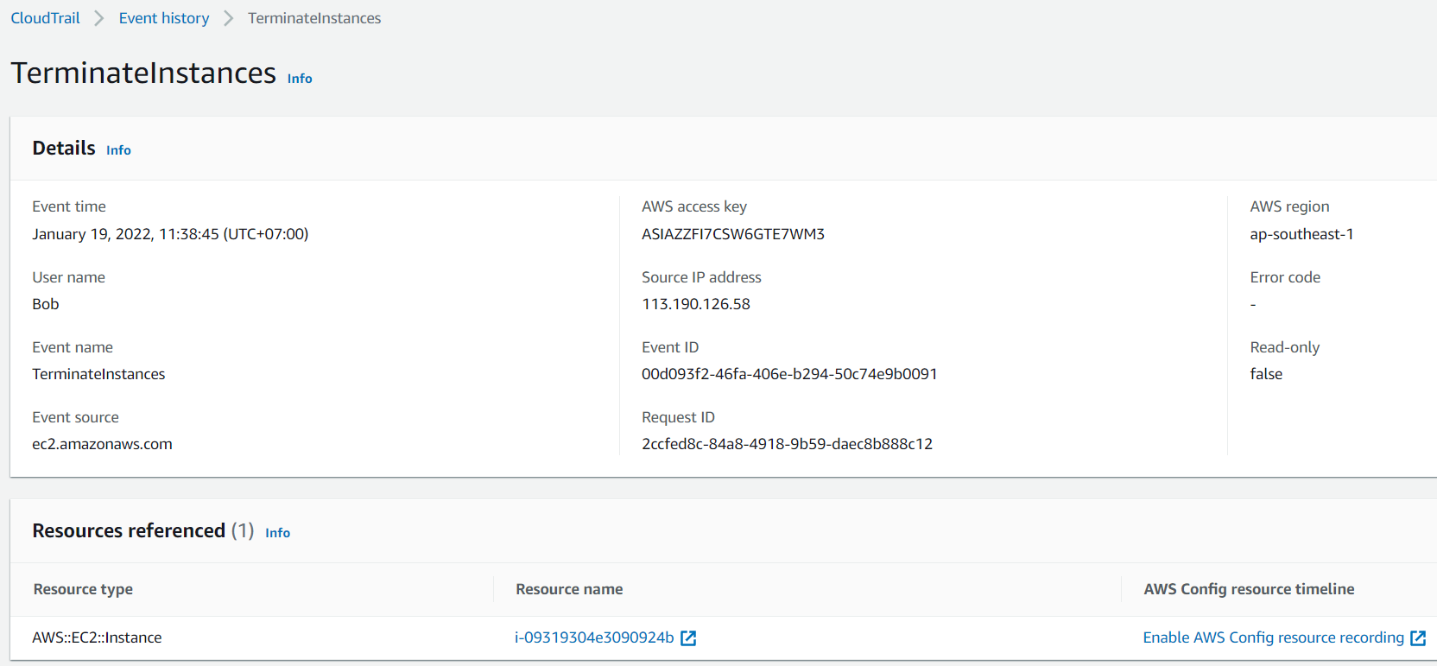
CloudTrail Service
  Event History
Filter event
All event
Detail record

Slide 6
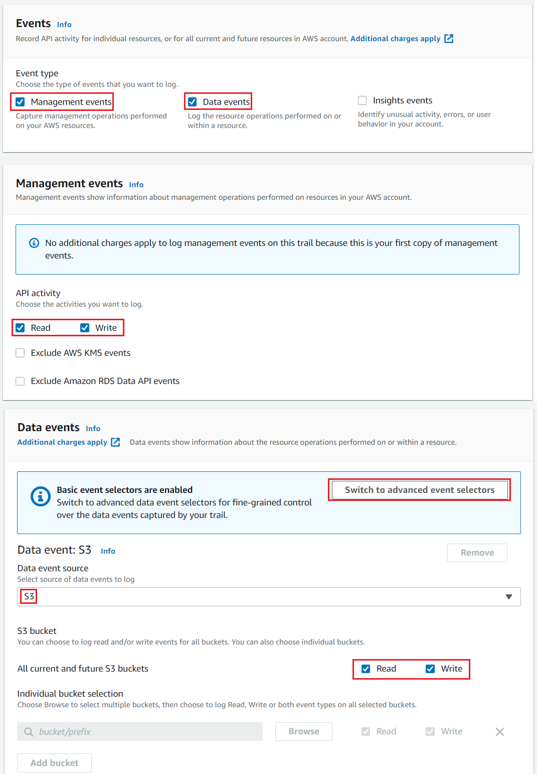
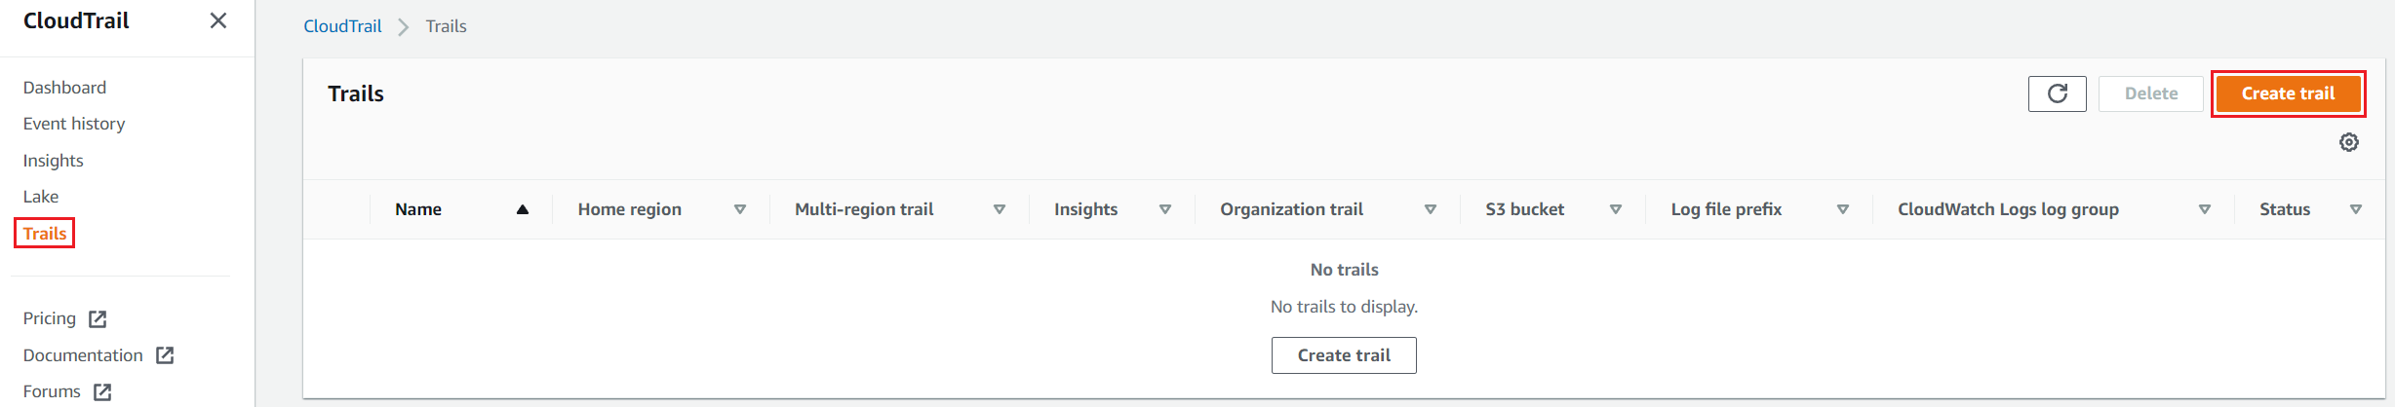
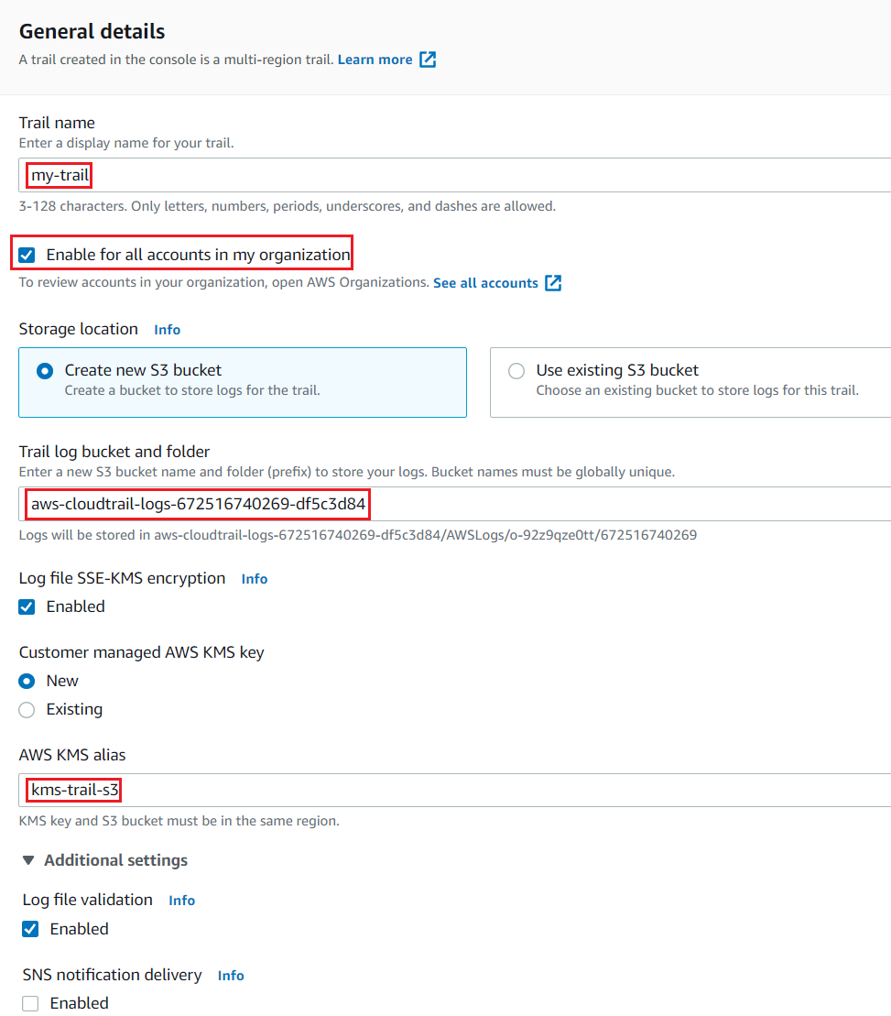
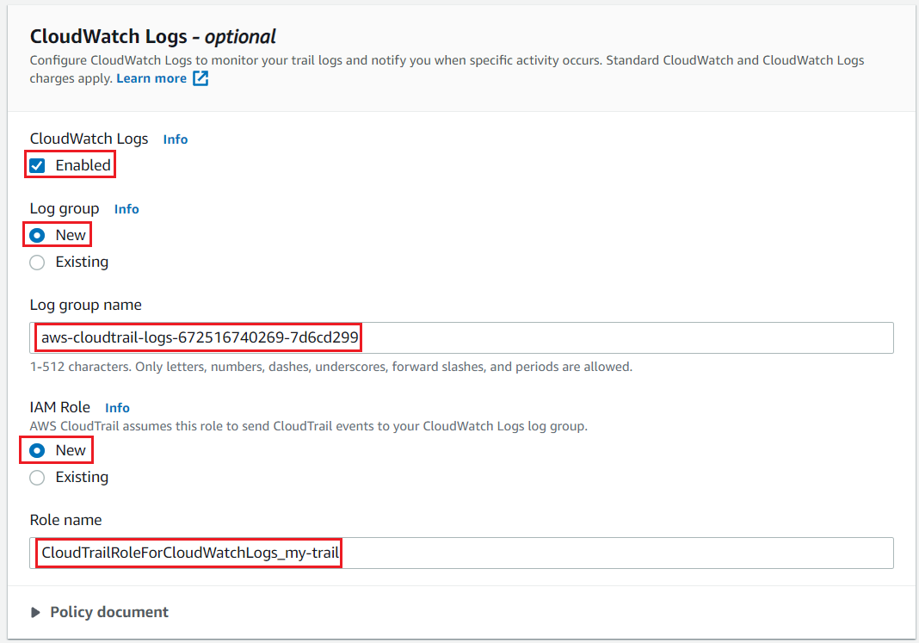
CloudTrail Service
  Create Trail
CloudWatch Log
Event

Slide 7
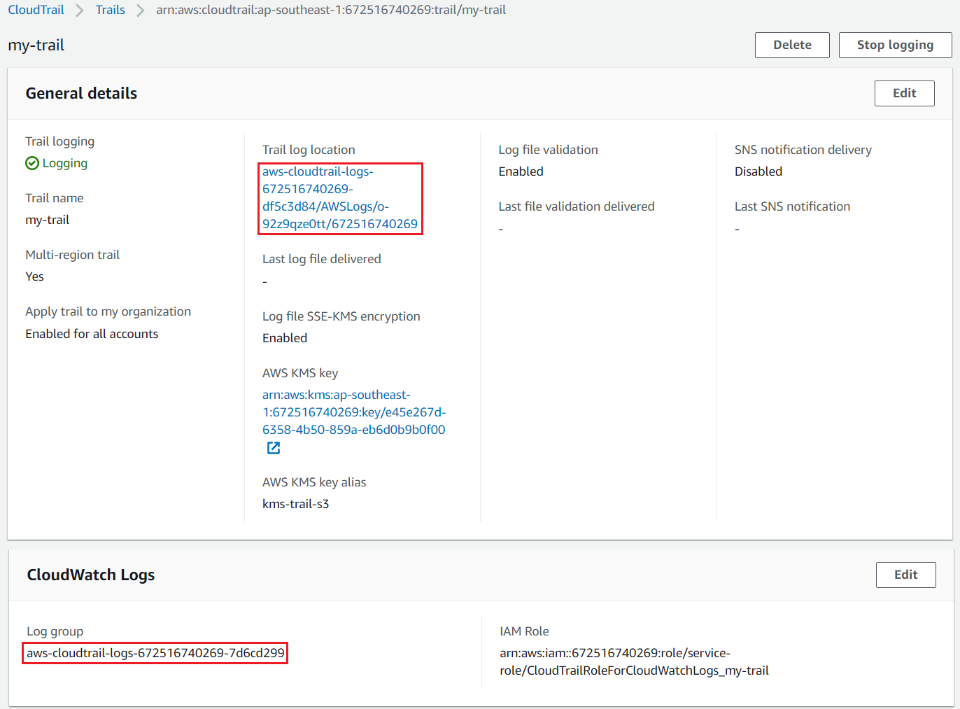
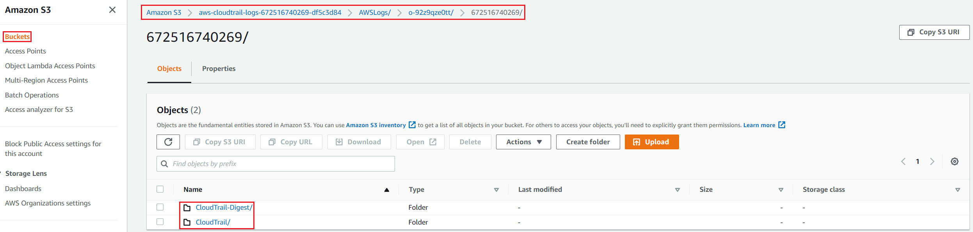
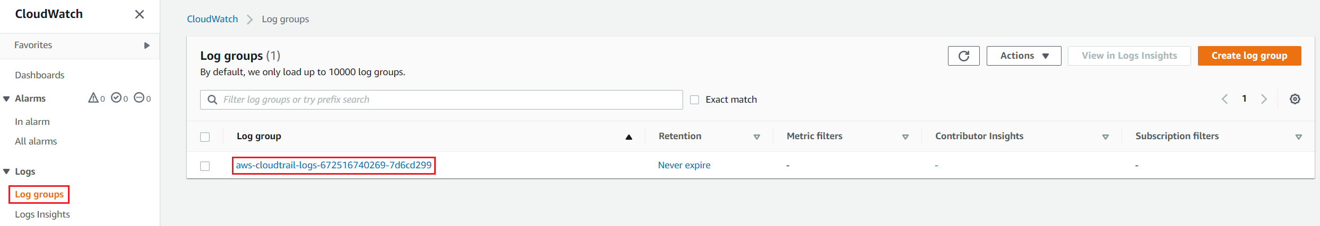
CloudTrail Service
S3
Detail Information
CloudWatch Log

Slide 8
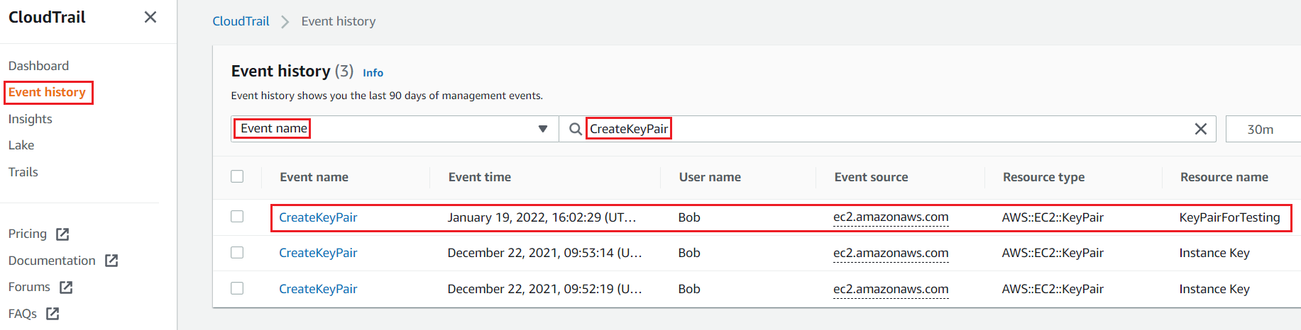
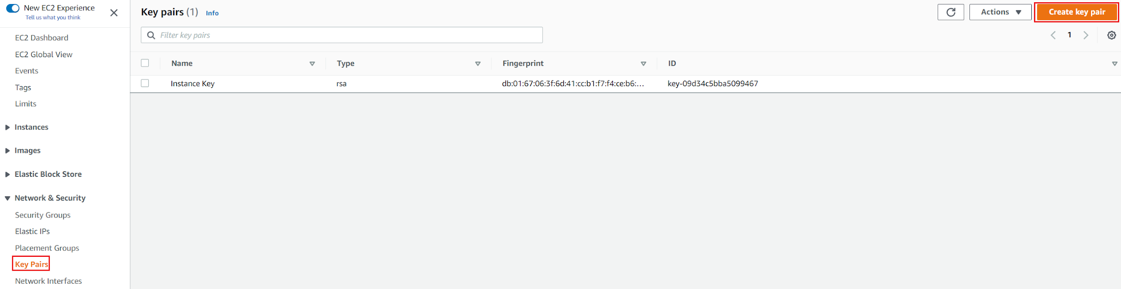
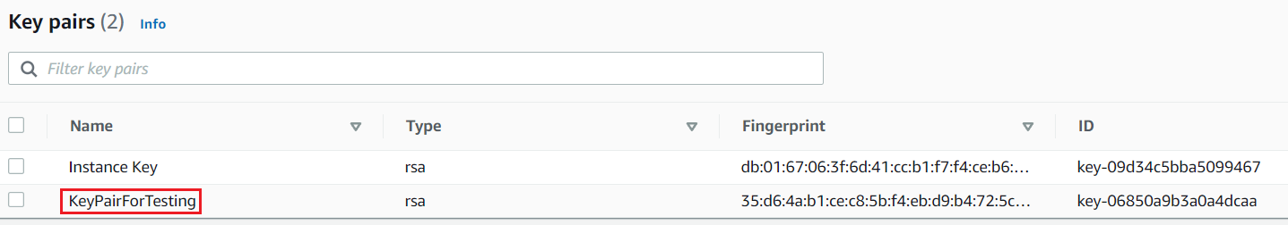
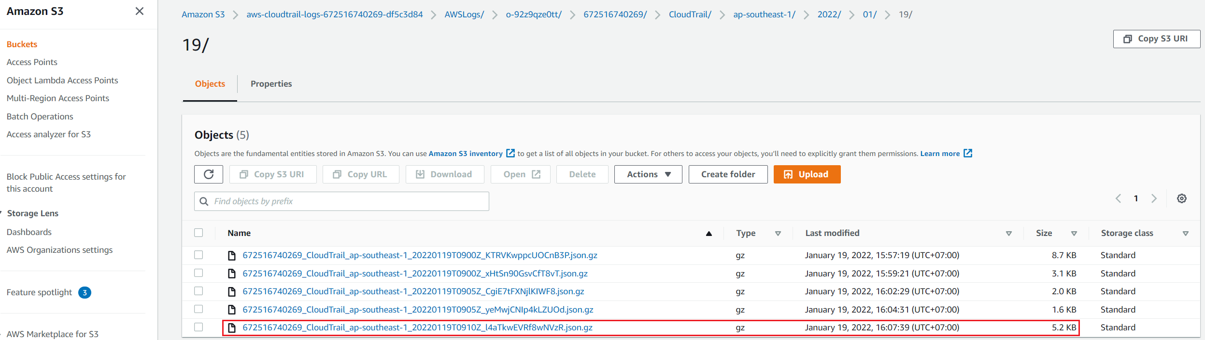
CloudTrail Service
  Test
CloudTrail
Create KeyPair
S3

Slide 9
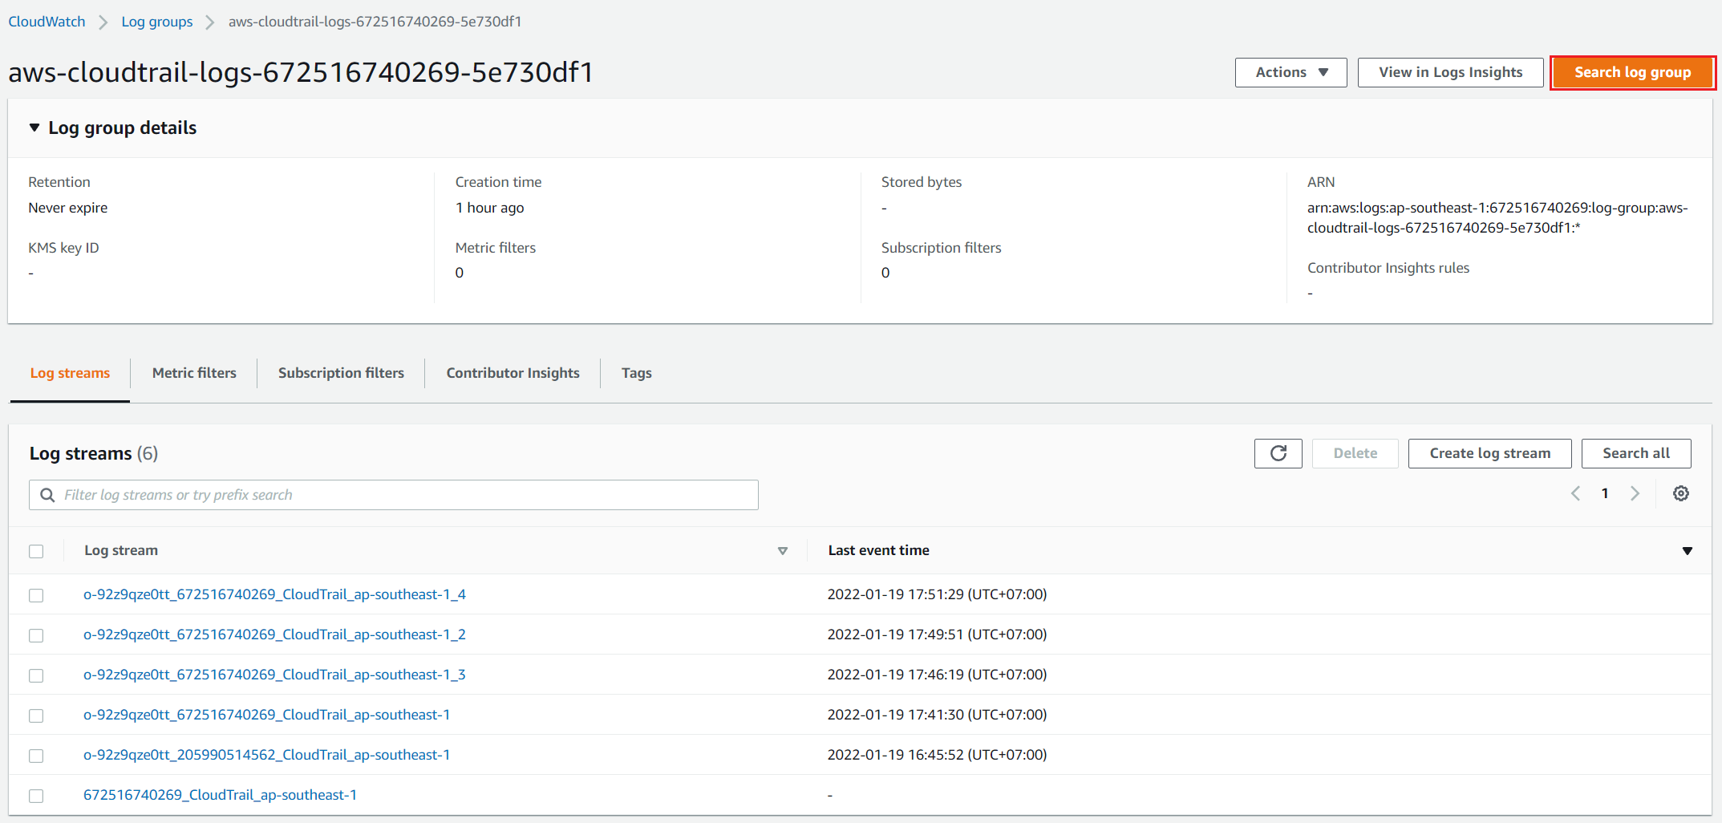
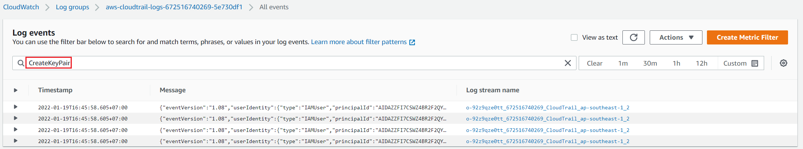
CloudTrail Service
CloudWatch Log

Slide 10
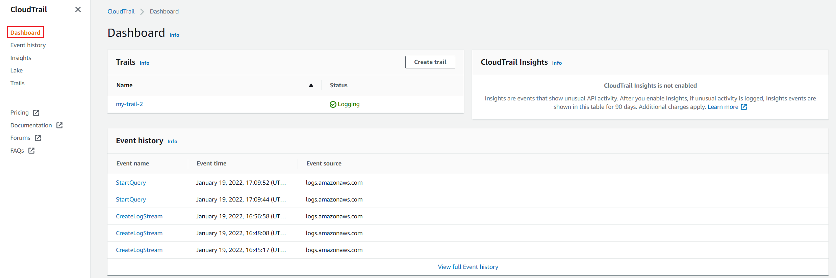
CloudTrail Service
  Dashboard

Slide 11
Assignment
  Self-practice

Slide 12
CloudTrail Service
Components
  Trail, Event history
  Event
  Log file
  Dashboard

Slide 13
CloudTrail Service
  Trail
    Support all account in my organization
    Support Multi-region
    Available trail of AWS: Event History
    You can view, search, download, archive, analyze, respond
Detail Information

Slide 14
CloudTrail Service
  Event history
    Available trail of AWS
    Default: enable for all regions
    Expired time: 90 days
All event

Slide 15
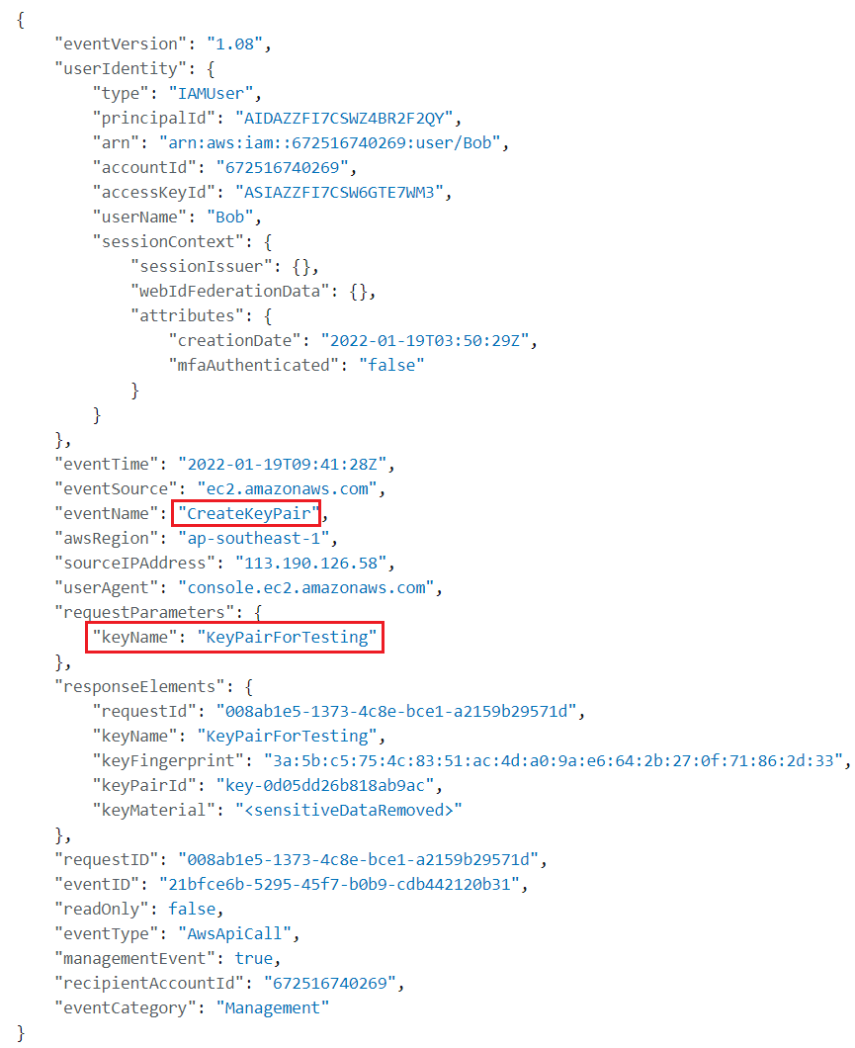
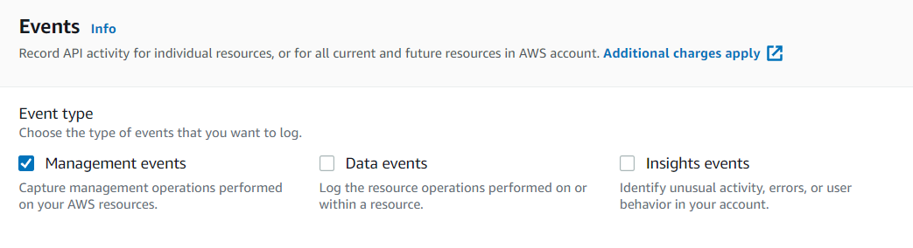
CloudTrail Service
  Event
    Manage records
    3 types
      Management event
      Data event
      Insights event
Record information

Slide 16
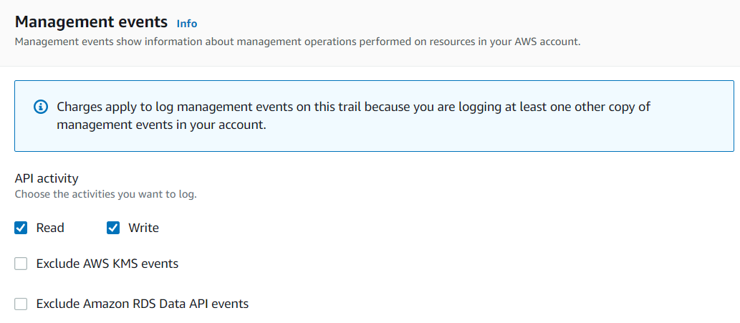
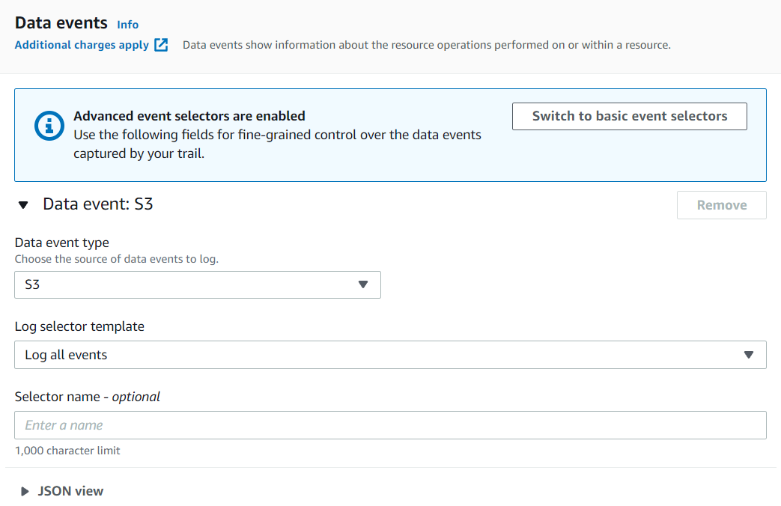
CloudTrail Service
      Management event
        Operations that are performed on resources in your AWS account
        Ex: IAM AttachRolePolicy, AWS CloudTrail CreateTrail, …
        Read / write API
        Default: Enable
      Data Events
        Operations that are performed on data
        Ex: S3 GetObject, DeleteObject, PutObject, …
        Default: disable

Slide 17
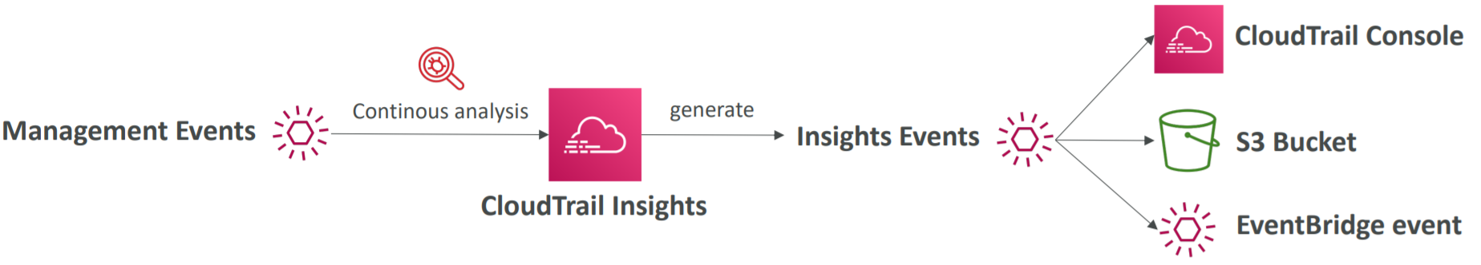
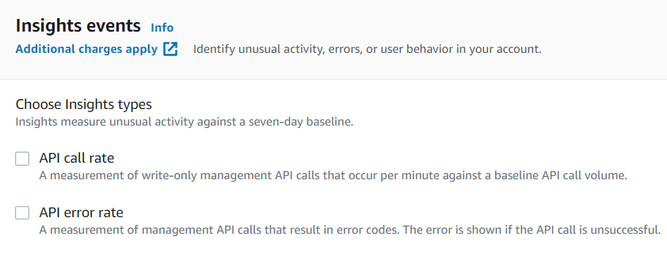
CloudTrail Service
      Insights event
        Detect unusual activity in your account
          Inaccurate resource provisioning
          Hitting service limits
          Bursts of AWS IAM actions
          Gaps in periodic maintenance activity
        API call rate / API error rate
Tutorial: https://www.youtube.com/watch?v=Nky1DUj9s1M

Slide 18
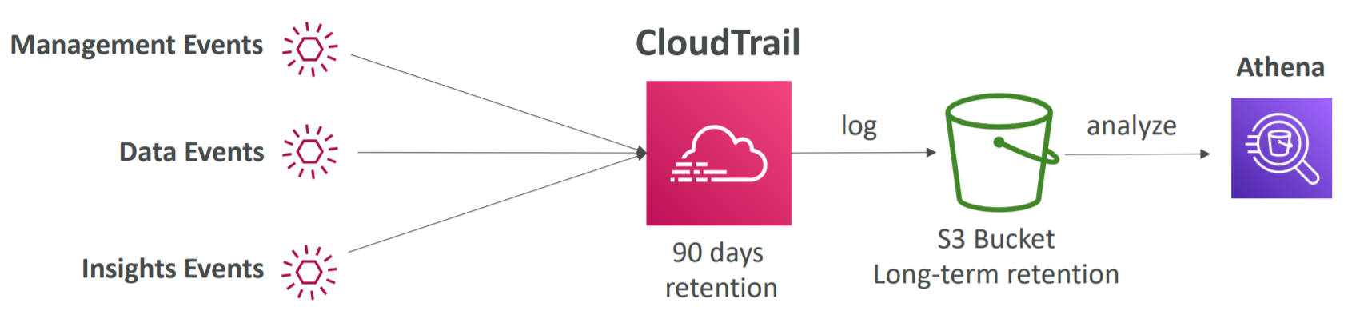
CloudTrail Service
  Log file
    Default: Stored for 90 days in CloudTrail 🡺 Stored in S3 with SSE-KMS encryption
S3

Slide 19
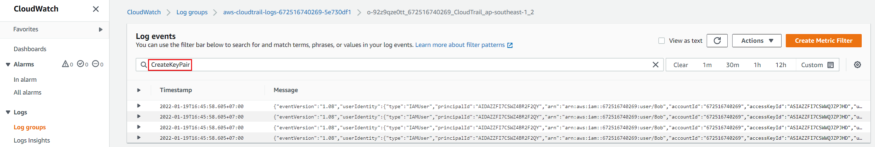
CloudTrail Service
    Using CloudWatch Log & Event to visualize, explore, filter, …
CloudWatch Log
Read more: https://www.youtube.com/watch?v=6b_ENVFgCpA

Slide 20
CloudTrail Service
  Dashboard

Slide 21
Assignment
  Self-practice

Slide 22
Q & A
Copyright © VTI Academy All Rights Reserved

